Slide 1
Human Rights Part 2
LO:
To start to consider which human rights might matter the most to themselves and others living in different places.
To consider what rights children should be entitled to receive.
To appreciate how human rights can apply in a variety of real-life challenging contexts.

Slide 2
Task: Watch the video and then complete the gap fill.
https://www.youtube.com/watch?v=oh3BbLk5UIQ&feature=youtu.be

Slide 3
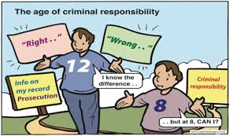

What age in my country? (Legal age for these activities…..) Criminal Responsibility
UK | UAE
10 years old | 10 years old

Slide 4

What age in my country? (Legal age for these activities…..) Buy a pet
UK | UAE
16 years old | ?

Slide 5
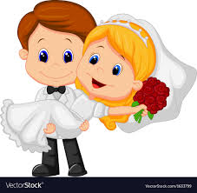
What age in my country? (Legal age for these activities…..) Get married with parents permission
UK | UAE
16 years old | 18 years old (Permission needed from a judge to get married before this)

Slide 6

What age in my country? (Legal age for these activities…..) Drive a car
UK | UAE
17 years old | 18 years old

Slide 7
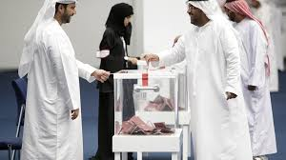
What age in my country? (Legal age for these activities…..) To vote
UK | UAE
18 years old | 25 years old
Notes:
http://www.youthpolicy.org/factsheets/country/united-arab-emirates/

Slide 8
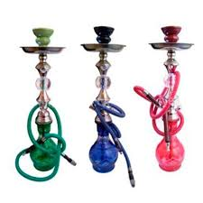
What age in my country? (Legal age for these activities…..) To smoke shisha
UK | UAE
18 years old | 28 years old
Notes:
http://www.youthpolicy.org/factsheets/country/united-arab-emirates/

Slide 9
Think- Pair – Share
Why does the law have age limits?
Why do these vary from country to country?
Are there any age limits that don’t seem fair or illogical? Can anything be done to change this?

Slide 10

Task – Rank the top 5 human rights which are most important to your life. Explain why they are important
Part 2: Read the “Life as a Refugee’ document. Which 5 rights are most important to their lives? Is this list similar or different to your own list?

Slide 11
Homework
Discuss the role of the UN in peacekeeping and conflict prevention and international justice, in support of human rights.

